Slide 1
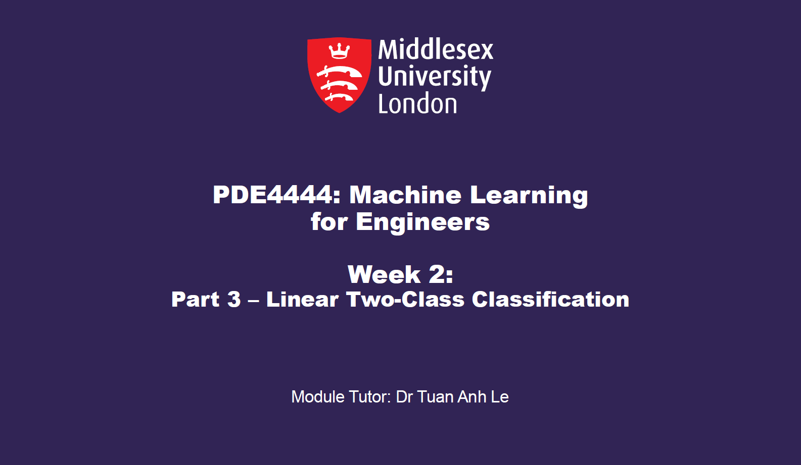
Week 4: Linear Unsupervised Learning
Part 3- K-Means
Dr Maha Saadeh

Slide 2
K-Means Algorithm
The focus of this Section - the K-means algorithm - is an elementary example of another set of unsupervised learning methods called clustering algorithms.

Slide 3
K-means Clustering
Goal: find the cluster for each observation while minimising the variance between data samples in each cluster
K-means algorithm
Each cluster is associated with a centroid
Each point is assigned to the cluster whose centroid it is closest to
The number of clusters, K, must be specified beforehand

Slide 4
K-means algorithm
Algorithm:
1: | Initialise K centroids (prototypes)
2: | repeat
3: | assign each data point to the nearest centroid
4: | update the centroids to be the cluster means
5: | until the centroids do not change
The simplest version is based on Euclidean distance

Slide 5


K-means algorithm
Algorithm:
Let’s call these two steps as Estimate and Measure
1: | Initialise K centroids (prototypes)
2: | repeat
3: | E-step: assign each data point to the nearest prototype
4: | M-step: update the prototypes to be the cluster means
5: | until the prototypes do not change
The simplest version is based on Euclidean distance

Slide 6
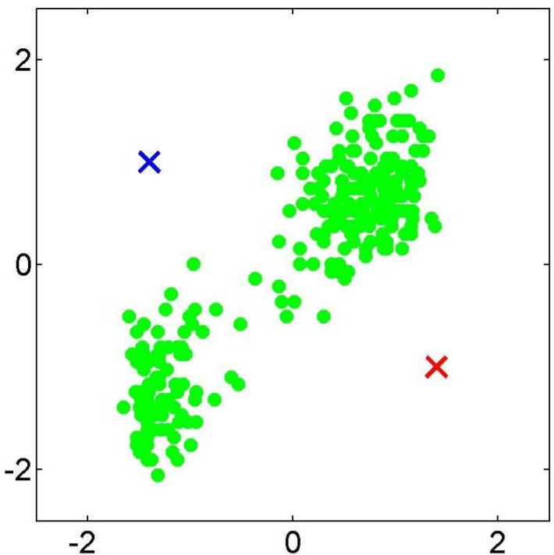
Initialise:

Slide 7
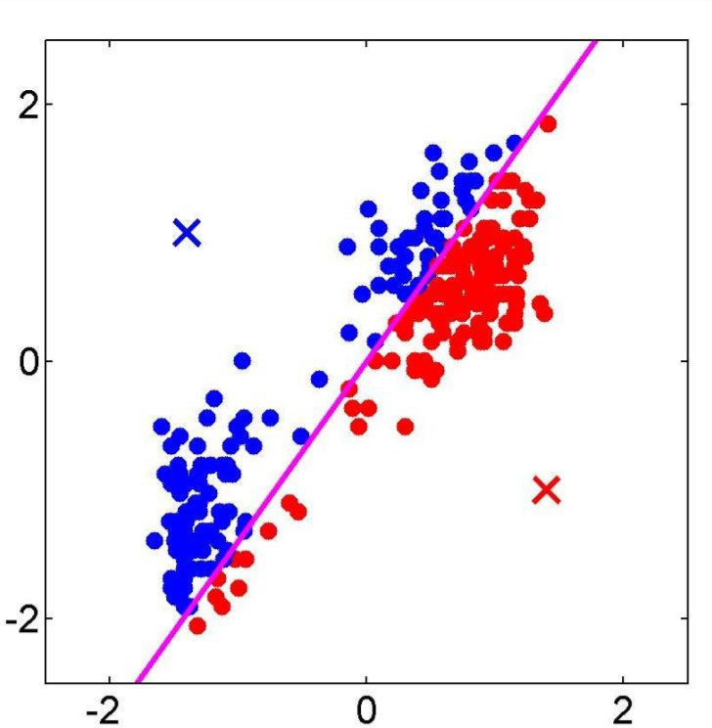
E-step:

Slide 8
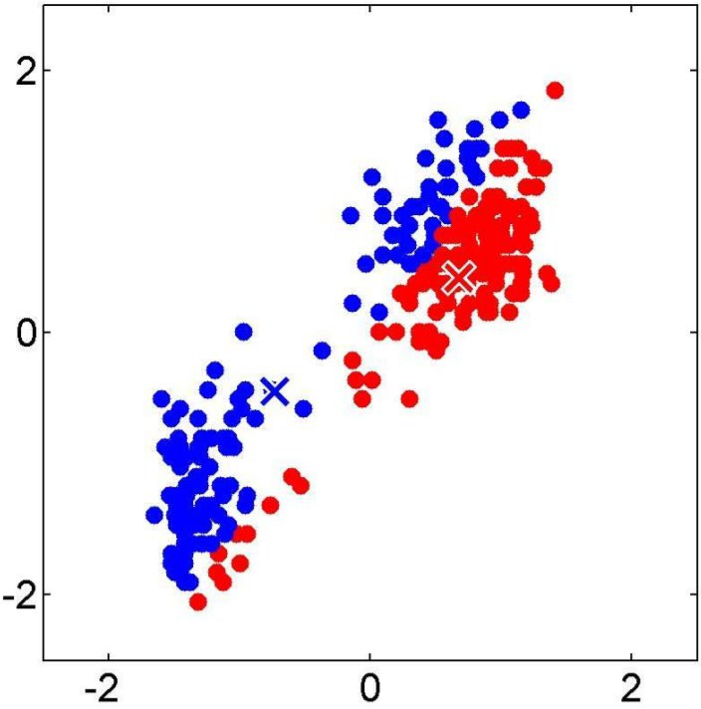
M-step:

Slide 9
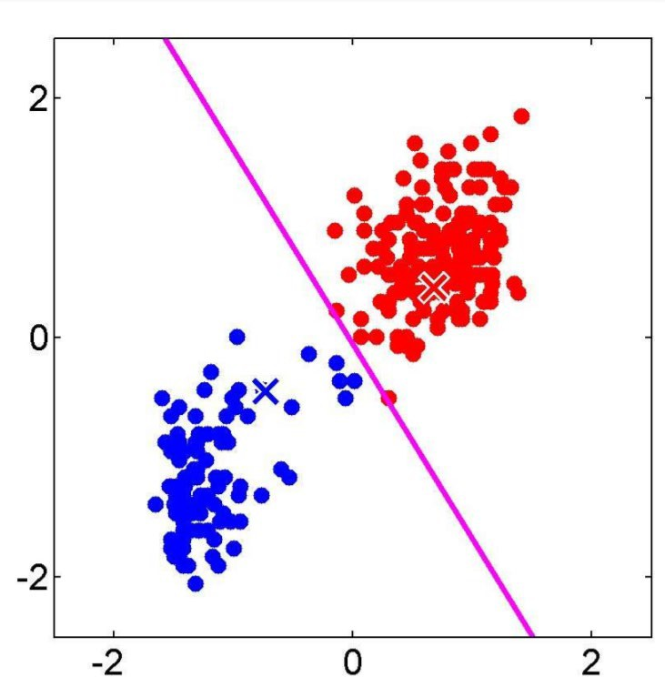
E-step:

Slide 10
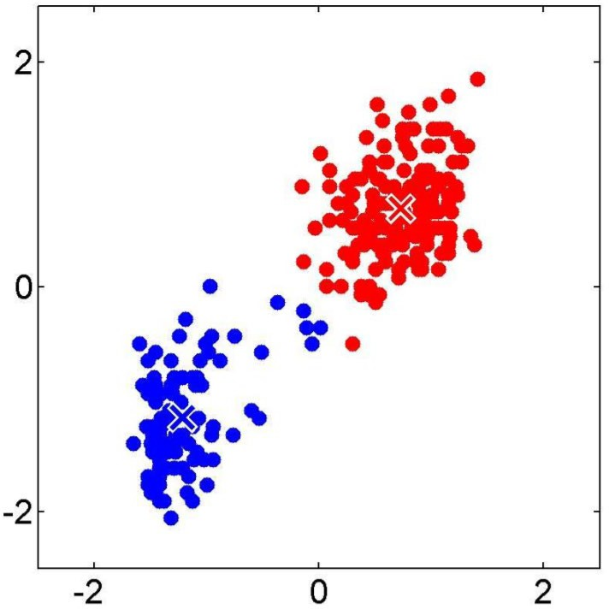
M-step:

Slide 11
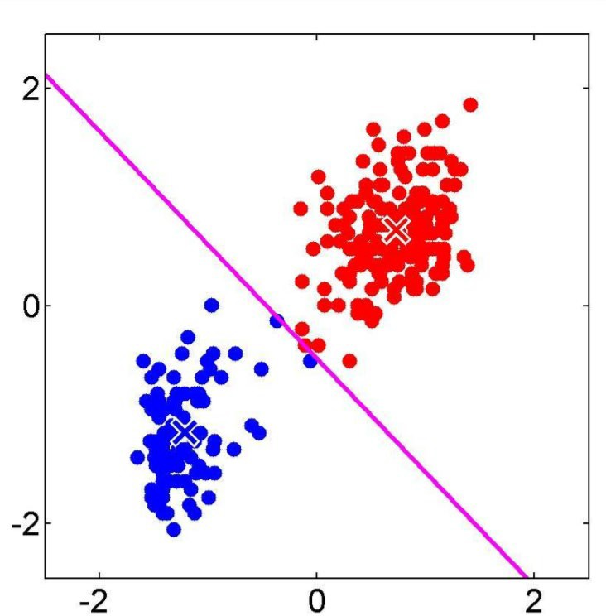
E-step:

Slide 12
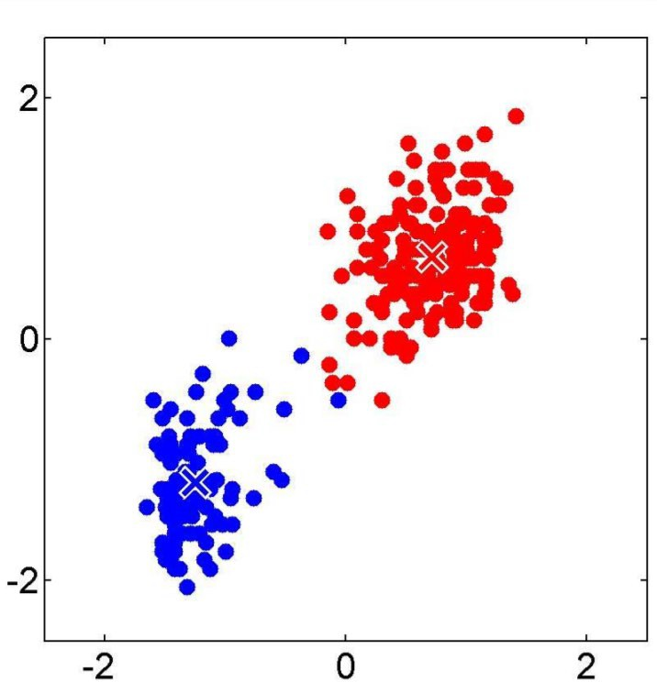
M-step:

Slide 13
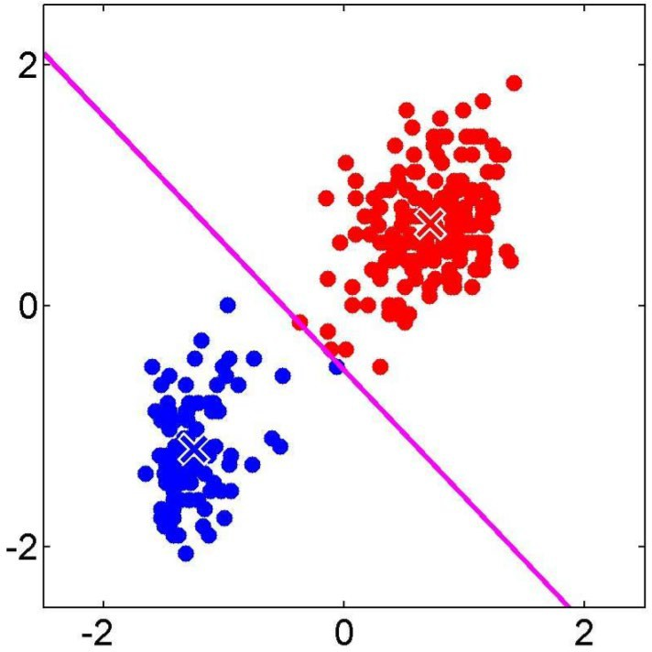
E-step:

Slide 14
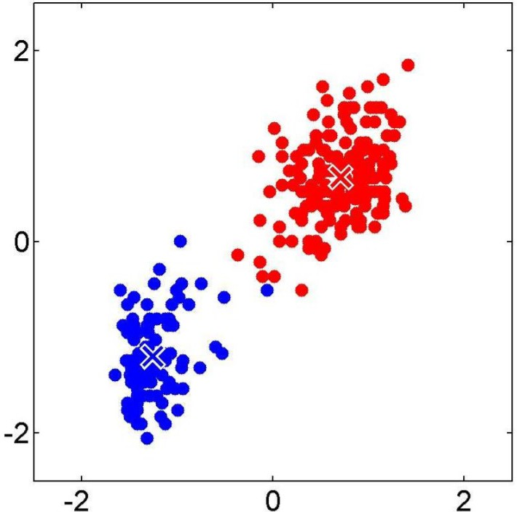
M-step:

Slide 15
No more modifications: Clustering is Done
Cluster 1
Cluster 2

Slide 16
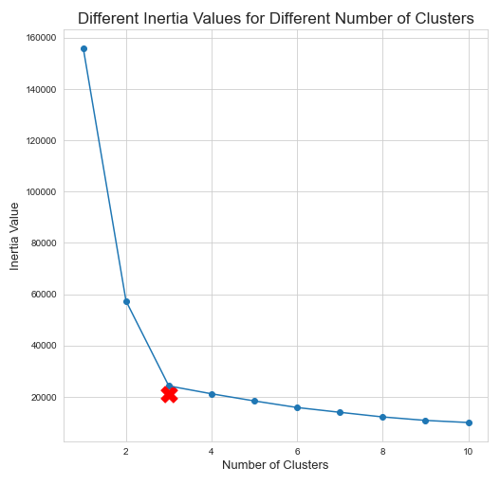
How to select K?
Using the Elbow method
Inertia metric:
Inertia measures how well a dataset was clustered by K-Means. It is calculated by measuring the distance between each data point and its centroid, squaring this distance (the variance), and summing these squares across one cluster

Slide 17
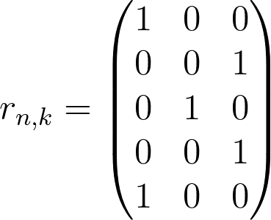



K-means Algorithm
Responsibilities assign the N data points to K clusters
– variables r
Example: 5 data points, 3 clusters
cluster 1
x₂
x₄
x₁
x₅
cluster 3
where
x₃
cluster 2
implies x₂ belongs to cluster k=3

Slide 18

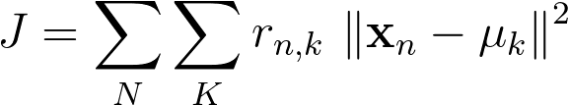




K-means Algorithm
Cost function J of the K-means algorithm
data
responsibilities
centroid / prototype
cluster 1
x₂
x₄
x₁
x₅
cluster 3
x₃
cluster 2

Slide 19
K-means and bad local minima
This roughly looks like it could be clustered into K=5 clusters

Slide 20
K-means and bad local minima
In this example we show how K-means can fail due to a poor choice of initial centroids.
Regardless, one can intuit that the quality of a K-means clustering surely depends on a high quality initialization.

Slide 21
K-Means and Initialization Method
Generally speaking, a good initializations is one where the initial centroids are spread evenly throughout the distribution of the data.
Conversely, a poor initialization is typically one where all of the initial centroids are bunched up together in a small region of the space.
This can make it difficult for the centroids to spread out effectively, leading to less than optimal clusterings or even 'empty clusters' (i.e., those to which no points are finally assigned).

Slide 22
Evaluation Metrics
The average intra-cluster distance provides us with a simple numerical way to compare the quality of various clusterings (when K is fixed).

Slide 23
Python Exercise
K-means

